Slide 1


Hemalatha Kandivan
8/1/2025

Slide 2

Outline
Executive Summary
Introduction
Methodology
Results
Conclusion
Appendix

Slide 3
Executive Summary
Space travel is the future and multimillionaires are investing in it. However, rocket launches are very costly but SpaceX’s Falcon 9 rocket’s first stage is reusable and saves a significant amount of cost. In this project, we would want to determine whether the first stage will land successfully and gather information relevant to the launches. We would like to build and find out the best model that predicts landing outcomes as well.
Methodologies:
The data was collected using SpaceX’s API and Beautiful Soup HTML webpage parser. Data wrangling was done by cleaning and preparing data for model training. Exploratory data analysis was done using Seaborn to visualize data and SQL to query relevant data. Folium was used to build an interactive map to view launch sites while a dashboard was constructed with Plotly Dash. Data was trained and tested using classification models and the best model was chosen with highest prediction accuracy.
Key Takeaways:
The success rate for landing outcome is 67% with highest successful landings on drone ships at 45%. Most successful launches came from launch site KSC LC-39A and ISS seems to be the most promising orbit when it comes to launch successes with heavy payloads. Boosters like B4 and FT successfully carried heavy payloads. All launch sites are located on the coastal areas with proximities close to railways and highways but further from cities. For predictive analysis, Decision Tree model gave the highest prediction accuracy for launch outcomes at 89%.

Slide 4
Introduction
Project background and context
Rocket launches are expensive but SpaceX’s Falcon 9 rockets can recover the first stage boosters significantly reducing launch costs. If the first stage landing outcome can be determined, the cost for each launch can be determined too. Besides that, we want to determine the factors that contribute to the launch successes to maximize the success rate of future launches.
Problems we want to find answers:
Will the first stage be reused (successful landing outcome)?
Which features or factors have contributed to the successes and failures of the launches?
Which classification model with best accuracy can be used to predict the landing outcomes?

Slide 5

Section 1

Slide 6
Methodology
Executive Summary
Data collection methodology:
SpaceX API
Beautiful Soup HTML Parser
Perform data wrangling
Dealing with missing values, generating labels and exploratory data analysis
Perform exploratory data analysis (EDA) using visualization and SQL
Perform interactive visual analytics using Folium and Plotly Dash
Perform predictive analysis using classification models
Defining X and Y data for training and testing, using GridSearchCV on models to find best parameters for tuning and best accuracy for data validation and prediction

Slide 7
Data Collection
Data sets were collected in two methods:
Using SpaceX API
Using Beautiful Soup HTML parser to parse Falcon 9 Wikipedia webpage content

Slide 8
Data Collection – SpaceX API
GitHub URL https://github.com/hemz19-05/Capstone-Project---IBM-Data-Science/blob/main/jupyter-labs-spacex-data-collection-api.ipynb
URL used to request launch data from SpaceX API and check response content
Used GET request to make the JSON content more consistent
Decoded content using .json and converted to pandas dataframe using .json_normalize()
Converted and cleaned data in the dataframe using created functions to obtain info like Booster version, launch sites and payload mass
Data stored in lists and converted to dictionary to create dataframe for easier analysis
Data filtered for Falcon 9 launches and missing values were replaced with mean

Slide 9
Data Collection - Scraping
Wikipedia URL used to request Falcon 9 launch data using HTTP GET method
Beautiful Soup object created from the HTML response
Column names extracted from HTML table header
Dataframe created with parsed column names using dictionary
GitHub URL https://github.com/hemz19-05/Capstone-Project---IBM-Data-Science/blob/main/jupyter-labs-webscraping.ipynb

Slide 10
Data Wrangling
Python libraries imported (Pandas, Numpy) and CSV data loaded into dataframe
Missing values with percentage and numerical/categorical columns identified
EDA was done and info like number of launch sites, orbits and their occurences as well as their mission outcomes were obtained
Outcomes were converted to 0 and 1 labels for ML model training and the success rate was determined
GitHub URL https://github.com/hemz19-05/Capstone-Project---IBM-Data-Science/blob/main/labs-jupyter-spacex-Data%20wrangling.ipynb

Slide 11
EDA with Data Visualization
Charts used and rationale:
Seaborn library was used for data visualization.
Scatter plots were used for data visualization to display the relationship between different features with launch successes/failures – here plots were done for flight number and payload mass vs launch sites and orbit types.
To compare orbit types with success rates, bar chart was used.
Line chart was used to visualize trends of success rates along the years.
GitHub URL https://github.com/hemz19-05/Capstone-Project---IBM-Data-Science/blob/main/edadataviz%20(1).ipynb

Slide 12
EDA with SQL
Queries done:
Query on unique launch sites & launch sites beginning with string ‘CCA’
Query on total payload mass carried by NASA boosters & average payload mass carried by booster F9 v1.1
Query on first successful landing outcome date in ground pad & failed landing outcomes by drone ship in 2015 with months
Query on booster names that have success in drone ship and payload mass (>4000 and <6000)
Query on total number of successful and failure missions & boosters that carried maximum payload mass
Query on landing outcomes by descending rank between dates
GitHub URL https://github.com/hemz19-05/Capstone-Project---IBM-Data-Science/blob/main/jupyter-labs-eda-sql-coursera_sqllite.ipynb

Slide 13
Build an Interactive Map with Folium
For Folium map, circles were added to indicate the launch site locations.
Markers were added to name the launch sites together with circles.
Marker colors were added to show success/failure outcomes for each launch site and marker clusters were added to show total number of launches in each site.
Proximities of launch site to nearest railway, coastline, highway and city were calculated and displayed using MousePosition and Polylines.
GitHub URL https://github.com/hemz19-05/Capstone-Project---IBM-Data-Science/blob/main/lab_jupyter_launch_site_location%20(6).ipynb
Kindly copy GitHub URL and view it on https://nbviewer.jupyter.org/

Slide 14
Build a Dashboard with Plotly Dash
Dropdowns were added to choose launch sites and display successful launches using pie chart
Range slider was added to select payload range and analyze launch outcomes on scatter plot
Callback functions were added to render the charts according to selected sites
GitHub URL https://github.com/hemz19-05/Capstone-Project---IBM-Data-Science/blob/main/Plotly%20Dash%20-%20SpaceX

Slide 15
Predictive Analysis (Classification)
Confusion matrix was used to visualize and summarize the performance of the models.
GitHub URL https://github.com/hemz19-05/Capstone-Project---IBM-Data-Science/blob/main/SpaceX_Machine%20Learning%20Prediction_Part_5%20(1).ipynb
The confusion matrix function was defined first. X (features) and Y (outcome) were defined
The data was then split into train and test sets using test size of 20% and random state of 2
Model objects were created and fit into GridSearchCV objects
Best parameters, accuracy for validation data and test accuracy score for each model were determined and confusion matrices were plotted for predicted data
Models and accuracy scores were compared with dataframe and bar plot. The best performing model was obtained
The features, X were standardized using StandardScaler

Slide 16
Results
Exploratory data analysis results
Interactive analytics demo in screenshots
Predictive analysis results

Slide 17

Section 2

Slide 18
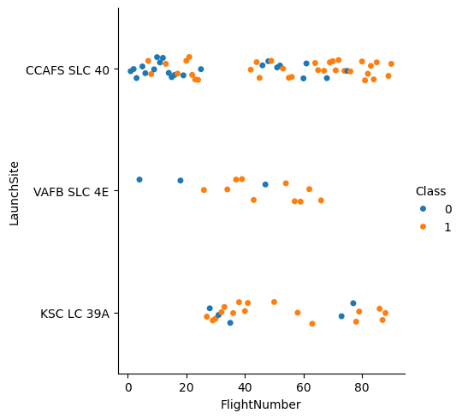
Flight Number vs. Launch Site
There are 3 launch sites on Figure 1 and we can see that most flights are successfully launched in CCAFS SLC-40 and least launches have been done in VAFB SLC 4E.
On the contrary, CCAFS SLC-40 also has the most failed launches among the 3 launch sites.
Figure 1: Flight Number vs Launch Site

Slide 19
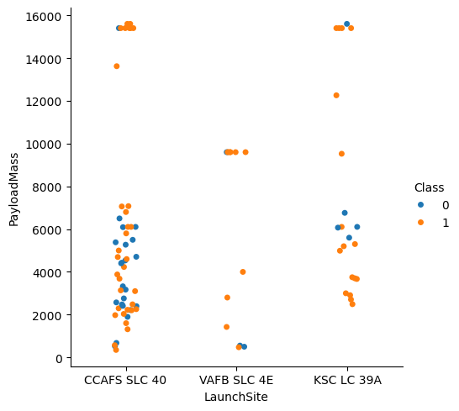
Payload vs. Launch Site
We can see on Figure 2 that both CCAFS SLC-40 and KSC LC-39A launch sites have launched rockets for massive payload mass of 16000kg.
For VAFB-SLC 4E site, there are no rockets launched for heavy payload mass - greater than 10000kg
Figure 2: Payload vs Launch Site

Slide 20
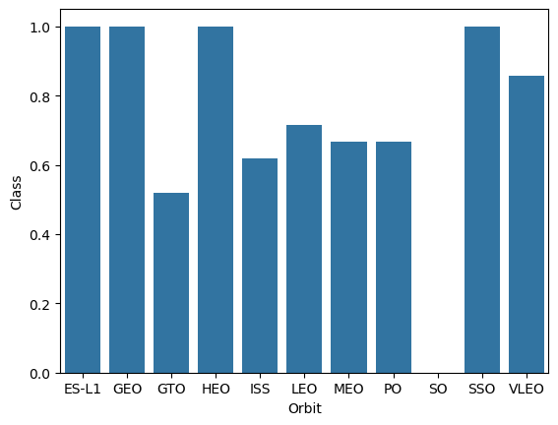
Success Rate vs. Orbit Type
We can infer from Figure 3 that the orbit types ES-L1, GEO, HEO and SSO have a mean success rate of 100% whereas GTO orbit has the lowest mean success rate at 50%.
Orbit SO has no mean success rate indicating that the launches are unsuccessful.
Figure 3: Success Rate vs Orbit Type

Slide 21
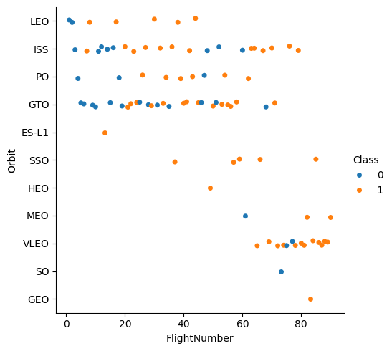
Flight Number vs. Orbit Type
Figure 4 shows that most flight launches were done at GTO and ISS orbits whereas ES-L1, SO, HEO and GEO have one launch each.
It can also be deduced that the most flight launch failures was at GTO among all the orbits.
Figure 4: Flight Number vs Orbit Type

Slide 22
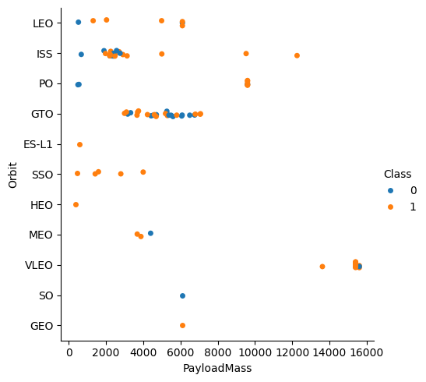
Payload vs. Orbit Type
Figure 5 shows that orbit VLEO has been used in launches with the heaviest payload mass at almost 16000kg, followed by ISS at 12000kg and PO at 10000kg.
It is notable that payload masses of 6000kg and below have been done in orbits like ES-L1, SSO, HEO and GEO and all the launches have been successful.
Figure 5: Payload vs Orbit Type

Slide 23
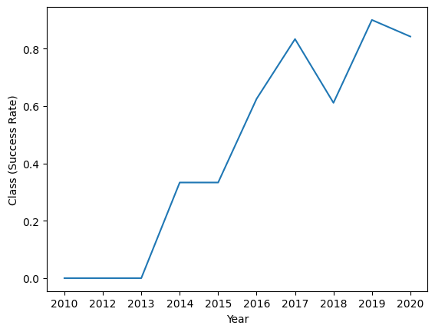
Launch Success Yearly Trend
There was no success seen in launches from 2010-2013. In 2014 there was a steep increase in success rate.
The success rate was the highest in year 2019 followed by 2017.
In 2018 the success rate took a dip to 60%.
Figure 6: Yearly Launch Success Trend

Slide 24
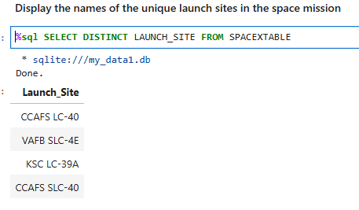
All Launch Site Names
Figure 7
Launch sites were queried from SPACEXTABLE using DISTINCT to get unique names.
There are 4 launch sites as shown on Figure 7.

Slide 25
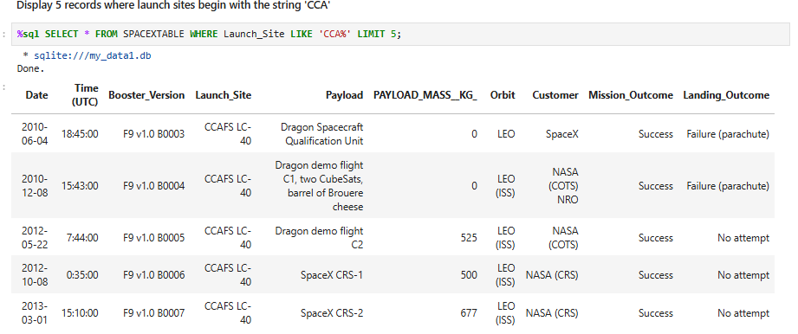
Launch Site Names Beginning with 'CCA'
Figure 8
- Launch sites beginning with ‘CCA’ were queried from SPACEXTABLE using WHERE to filter column ‘Launch_Site’ and LIKE to filter ‘CCA%’ and LIMIT to 5 records as requested.

Slide 26
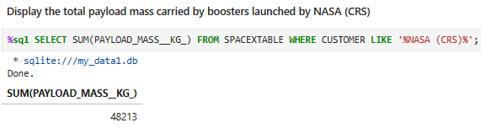
Total Payload Mass by NASA (CRS)
Figure 9
- Total Payload Mass from SPACETABLEX was queried using WHERE to filter column ‘CUSTOMER’ and LIKE ‘%NASA (CRS)%’ to filter NASA and total payload mass was obtained using aggregate function SUM on ‘PAYLOAD_MASS_KG_’.

Slide 27
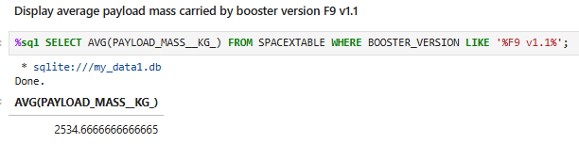
Average Payload Mass by F9 v1.1
Figure 10
- Average Payload Mass from SPACETABLEX was queried using WHERE to filter column ‘BOOSTER_VERSION’ and LIKE ‘%F9 v1.1%’ to filter the booster and the average payload mass was obtained using aggregate function AVG on ‘PAYLOAD_MASS_KG_’.

Slide 28
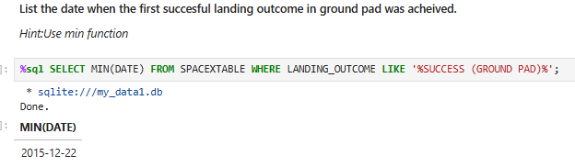
First Successful Ground Pad Landing Date
Figure 11
- The first successful landing outcome date from SPACETABLEX was queried using WHERE to filter column ‘LANDING_OUTCOME’ and LIKE ‘%SUCCESS (GROUND PAD) %’ to filter and the date was obtained using aggregate function MIN on ‘DATE’.

Slide 29
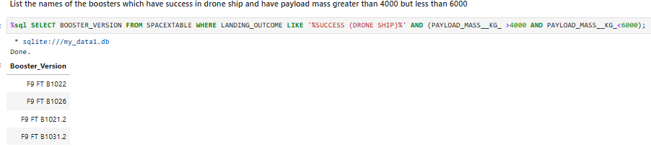
Successful Drone Ship Landing with Payload between 4000 and 6000
Figure 12
- The query was done for SPACEXTABLE using SELECT from column ‘BOOSTER_VERSION’, and WHERE and LIKE to filter ‘%SUCCESS (DRONE SHIP)%’ from ‘LANDING_OUTCOME’, and filtering ‘PAYLOAD_MASS_KG_’ between 4000 AND 6000.

Slide 30
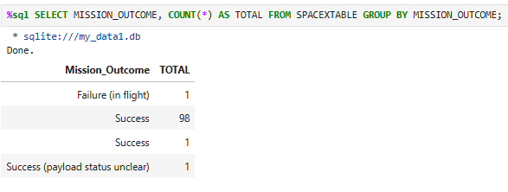
Total Number of Successful and Failure Mission Outcomes
Figure 13
From SPACEXTABLE, aggregate function COUNT was used on GROUP BY ‘MISSION_OUTCOME’ as ‘TOTAL’ to find out the total number of successful and failure outcomes.

Slide 31
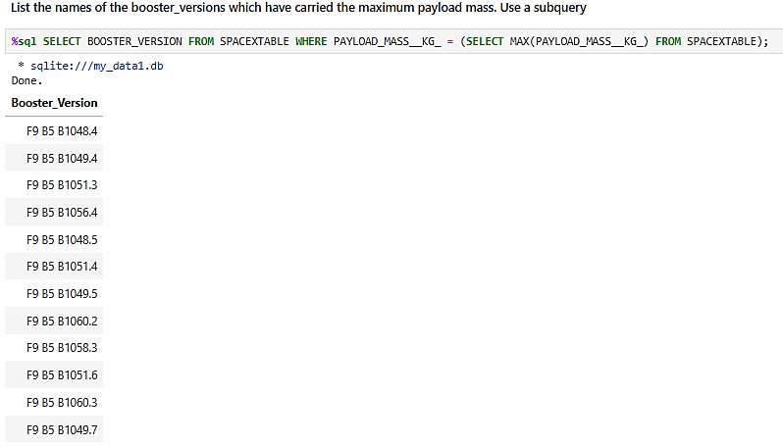
Boosters Carried Maximum Payload
Using a subquery for MAX on ‘PAYLOAD_MASS_KG_’, the boosters that carried maximum payload mass were obtained from column ‘BOOSTER_VERSION’.
Total 12 boosters were identified.
Figure 14

Slide 32
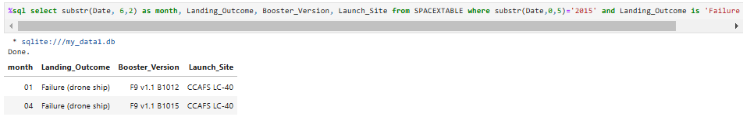
2015 Launch Records
Figure 15
- For failed drone ship landings in 2015, substrings were used to extract the months in year ‘2015’ from columns Landing_Outcome with WHERE to filter the records for ‘FAILURE (DRONE SHIP)’.

Slide 33
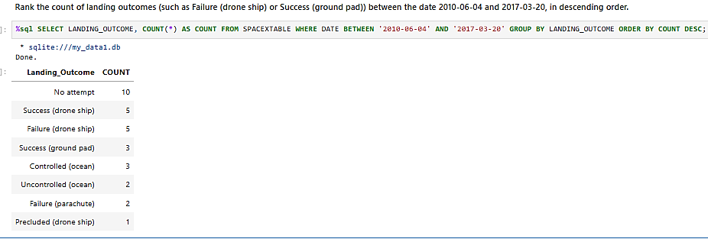
Rank Landing Outcomes Between 2010-06-04 and 2017-03-20
Figure 16
- From ‘LANDING_OUTCOME’ column in SPACEXTABLE, dates where filtered using WHERE and AND. COUNT and GROUP BY was applied to ‘LANDING_OUTCOME’ to obtain the total and types of landing outcome respectively. ORDER BY COUNT DESC was used to rank the total of landing outcomes in descending order.

Slide 34

Section 3

Slide 35
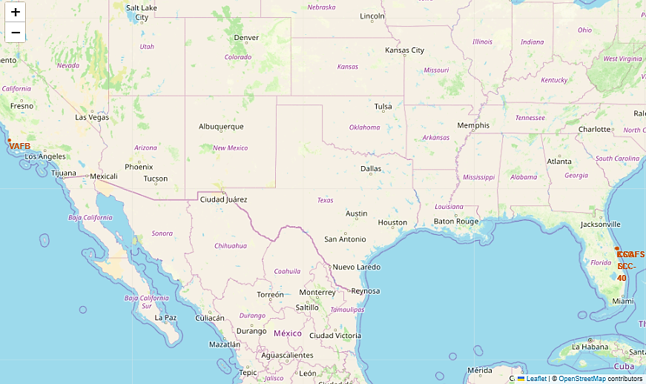
Launch Sites Location Marker
There were 4 launch sites found on the map on Figure 17:
1. CCAFS LC-40
2. CCAFS SLC-40
3. KSC LC-39A
4. VAFB SLC-4E
All the launch sites were found to be on the coastal areas of US, one in the west coast (California) and three in the east coast (Florida).
Figure 17

Slide 36
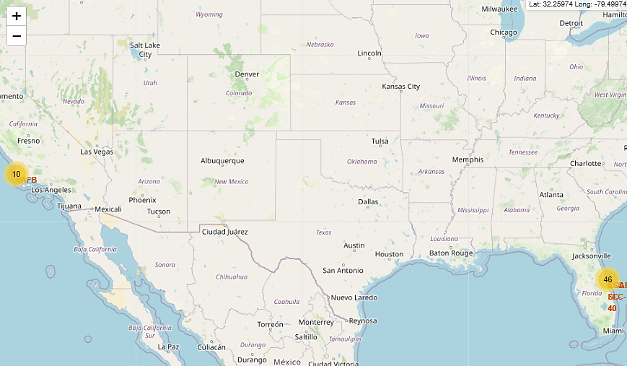
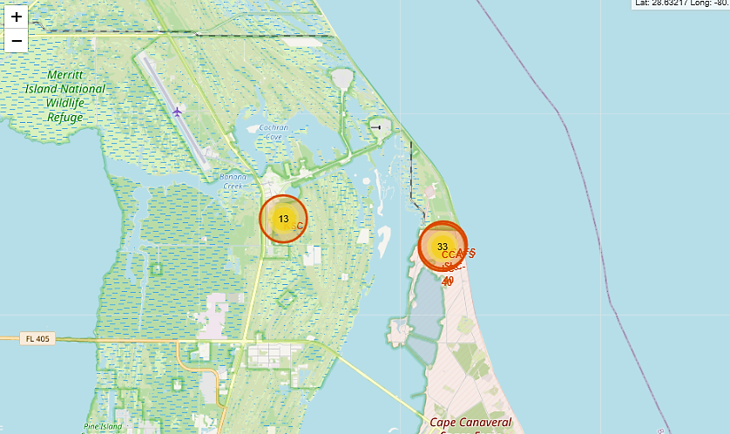
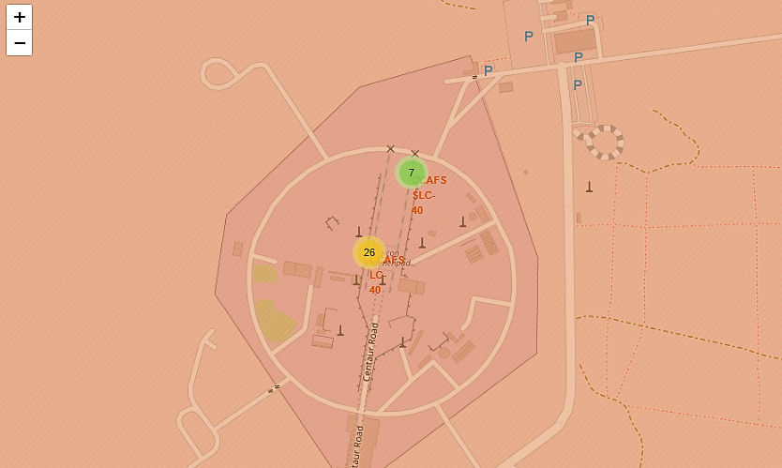
Colour-labeled Launch Outcomes
Figure 18 : Global map with colour markers and launch outcomes for launch sites.
Figure 19: Zoomed in of map showing launch outcome markers for KSC LC-39A (13) and both CCAFS (33) launch sites.
Figure 20: Zoomed in map with launch outcome markers for both CCAFS LC-40 (26) and CCAFS SLC-40 (7) launch sites (left).
* It is noted that most launches have been done in the east coast launch sites with CCAFS LC-40 being the highest to carry out launches (26).

Slide 37
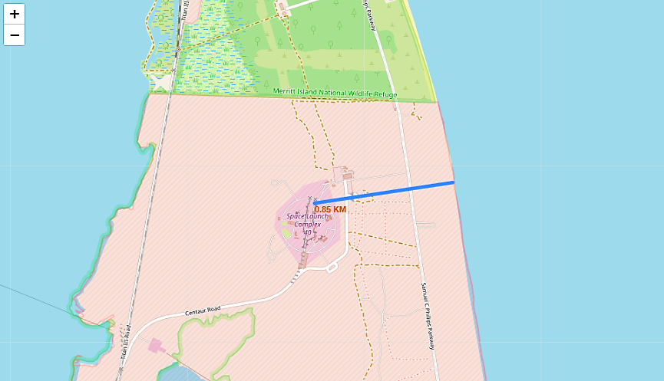
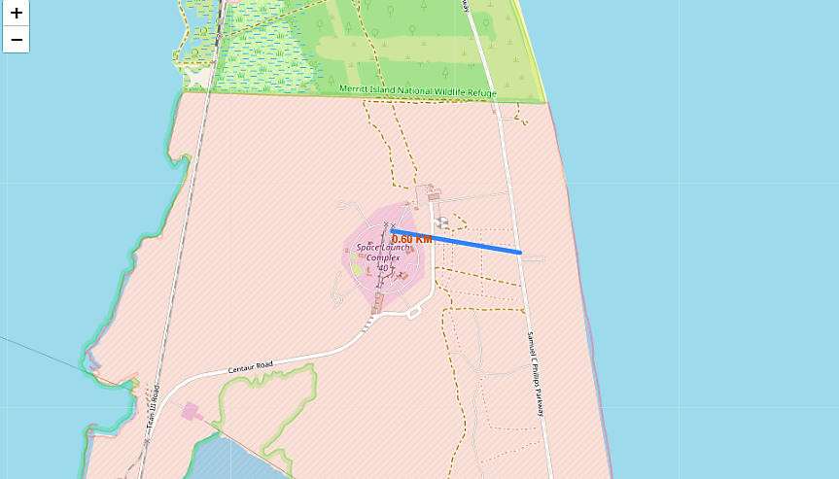
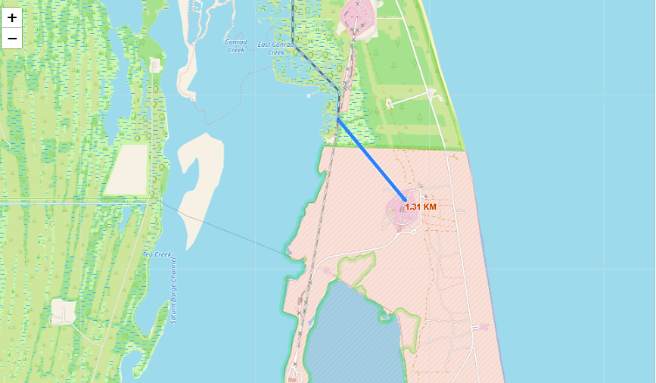
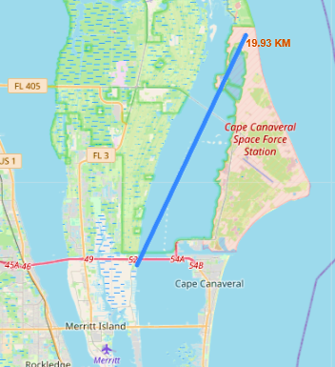
Launch Site Proximities to Points of Interest
Figure 21: Launch site to nearest coastline with distance 0.85km
Figure 22: Launch site to nearest highway with distance 0.6km
Figure 23: Launch site to nearest railway with distance 1.31km
Figure 24: Launch site to nearest city – Merritt Island with distance 19.93km

Slide 38

Section 4

Slide 39
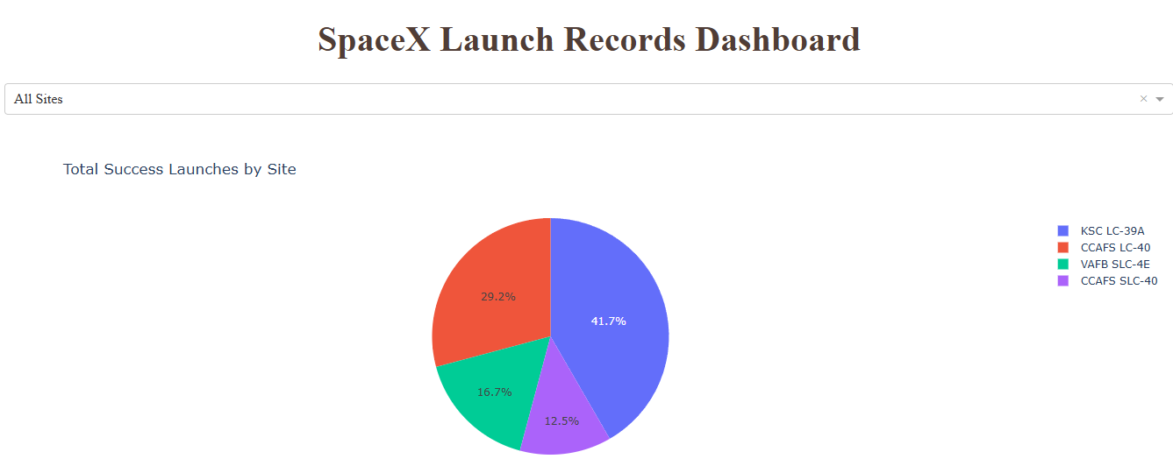
Launch Success Count for All Sites
The greatest launch successes was seen in launch site KSC LC-39A, followed by CCAFS LC-40, VAFB SLC-4E and CCAFS SLC-40.
Figure 25

Slide 40
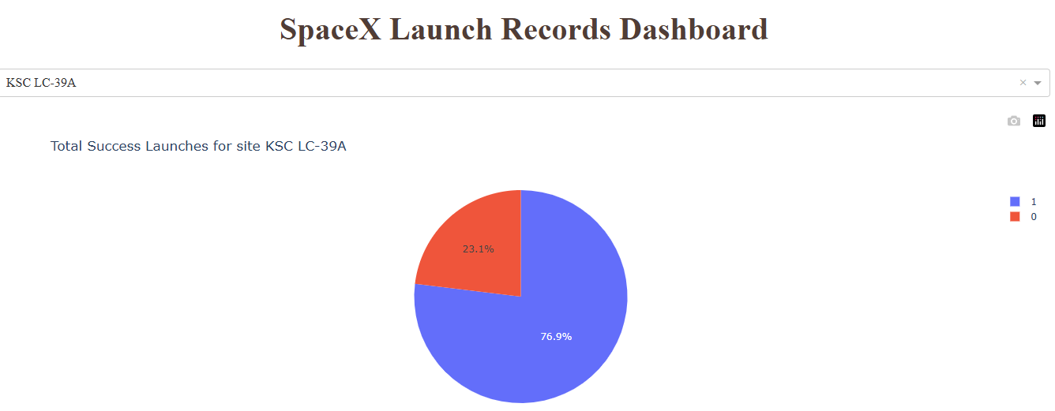
Launch Site with Highest Launch Success Ratio
Figure 26
The launch site with the highest launch successes, KSC LC-39A has a success-failure ratio of 76.9% success and 23.1% failure.

Slide 41
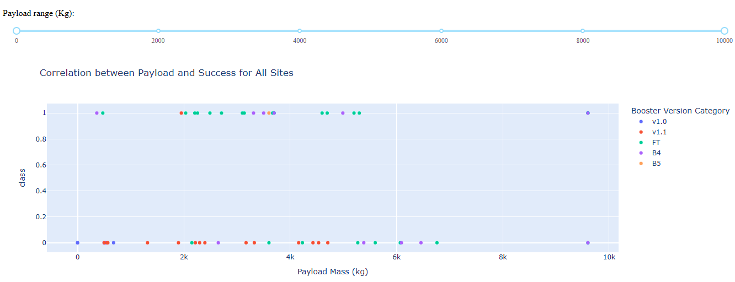
Payload vs Launch Outcome for All Sites
Figure 27
The booster versions that has the most successes was FT (payloads within range 6k) and most failures was v1.1.
Payload range that has the highest launch success rate is 2k-4k whereas the lowest success rate is seen within 8k-10k. There were no successes seen with 6k-8k range.
We can also conclude that booster B4 has successfully carried heavy payloads up to 10k.

Slide 42

Section 5

Slide 43
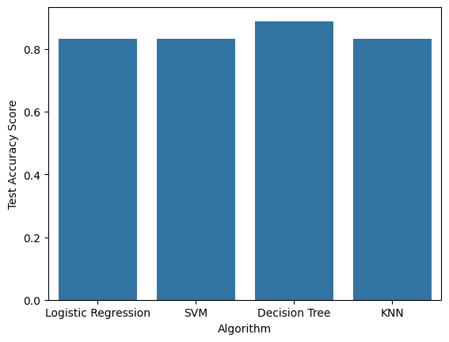
Classification Accuracy
Figure 28 shows 4 classification algorithms used to train and test data with test accuracy scores.
The model that has highest classification accuracy is Decision Tree at 89% test accuracy.
It is found that the rest of the models have similar accuracy scores of 83%.
Best parameters from Decision Tree –
'criterion': 'gini’
'max_depth’: 8
'max_features': 'sqrt’
'min_samples_leaf’: 1
'min_samples_split’: 2
'splitter': 'best’
Figure 28

Slide 44
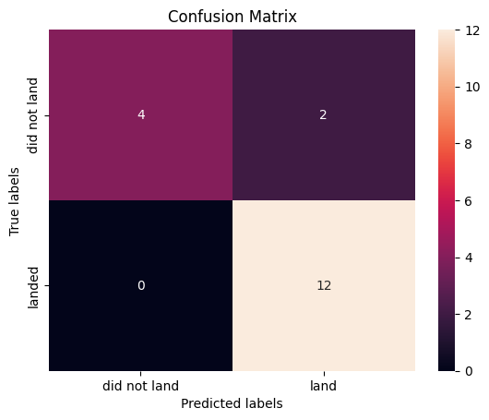
Confusion Matrix
For Decision Tree model:
‘Did not land’
True Labels - 6
Predicted Labels - 4 (2 false negatives)
‘Landed’
True Labels – 12
Predicted Labels – 14 (2 false positives)
In the other models like KNN, SVM and Logistic Regression, the false positives and false negatives are more (3 each) which suggests that the best model is Decision Tree with least false negatives and false positives.
Figure 29

Slide 45
Conclusions
The success rate for landing outcome is at 67% with highest successful booster landings on drone ships at 45%.
Most successful launches came from launch site KSC LC-39A with most launches done into orbits GTO and ISS, and ISS having higher mean success rate compared to GTO at 60% vs 50% respectively.
Boosters like FT has successfully carried payloads within 6000kg range and B4 carried massive payloads up to 10000kg. Most launch success were seen in orbits VLEO and ISS with massive payloads (<16000kg).
All launch sites are located on the coastal areas with proximities close to railways and highways but further from cities.
For predictive analysis, Decision Tree model gave the highest accuracy for predicting the launch outcomes for future data at 89%.

Slide 46
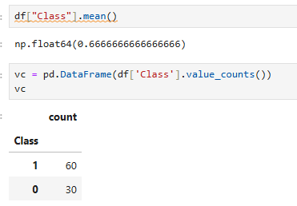
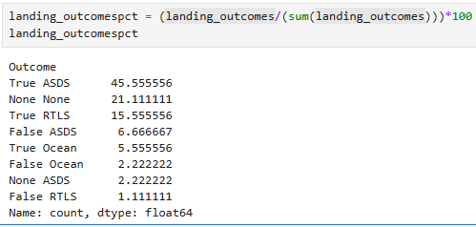
Appendix
Include any relevant assets like Python code snippets, SQL queries, charts, Notebook outputs, or data sets that you may have created during this project
Figure 30
Figure 31
Landing outcomes ‘Class’ with 1 being successful and 0 being failure shows that mean success rate of Falcon 9 launches at 67%.
The highest successful mission outcomes was landings on drone ships at 45%.

Slide 47


